Slide 1
Individual Activity: 2_2 Task: Interfacing Stepper Motor with Beaglebone Black
Submitted by: Submitted to:
Navjot Saini (C0751275) Prof. Mike Aleshams

Slide 2
List of Contents
IoT based Automatic Railway Gate Controller
Purpose of Stepper Motor in the Project
Hardware and Software Requirements
Specification of Stepper motor
Connection diagram of Beaglebone Black with Stepper Motor using ULN 2003 driver circuit
Pin connections between BBB and ULN 2003 Driver Circuit
Pin connection between Stepper Motor and ULN2003AN driver IC
Circuit Diagram
Software code – Eclipse IDE
Overview of Code
Runnig code on Beaglebone Black
References

Slide 3
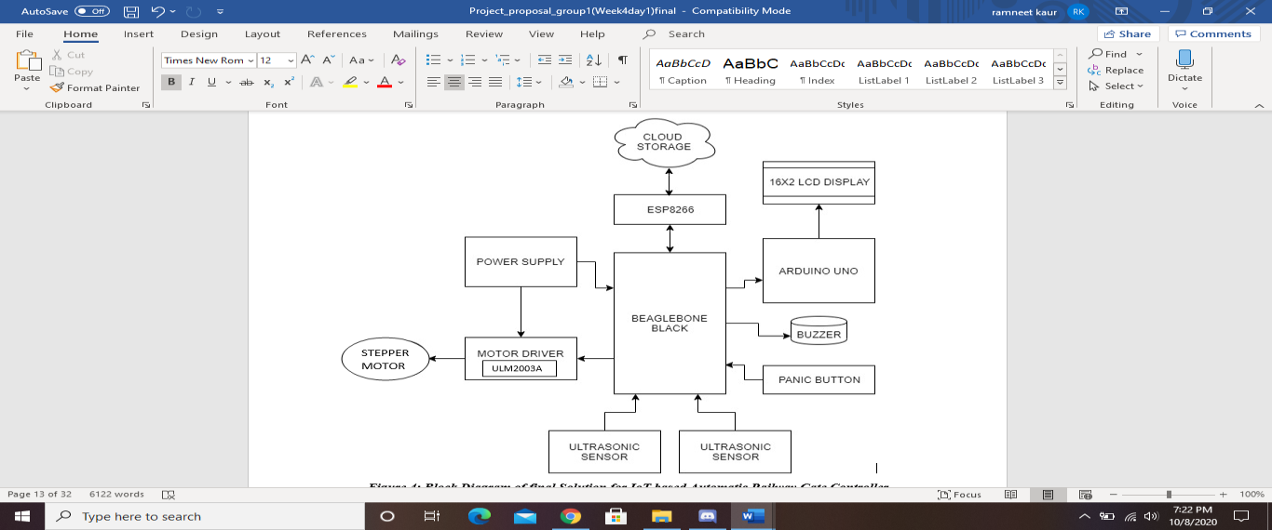
IoT based Automatic Railway Gate Controller

Slide 4
Purpose of Stepper Motor in the Project
Use of Stepper motor interfaced with motor driver circuit ULN2003 for closing and opening of gates.
ULN2003 motor driver IC can be used to interface stepper motor with BeagleBone Black and it is connected to GPIO pins of BBB.
Case 1:
When first ultrasonic sensor detect arrival of the train, then BBB control stepper motor to close the gate.
Case 2:
When second ultrasonic sensor detect departure of the train, then BBB control stepper motor to open the gate.
The motor will rotate ar 90 degree to close and open gate in clockwise and anticlockwisw direction

Slide 5
Hardware and Software Requirements
Hardware Requirements:
Stepper motor (28BYJ-48 )
ULN2003 motor driver circuit
Beaglebone Black
Power adaptor
Jumper wires
USB wire
Power supply module
Software Requirements:
Debian OS
Linux Operating System
Nano Editor
GCC compiler to run code
Eclipse IDE

Slide 6
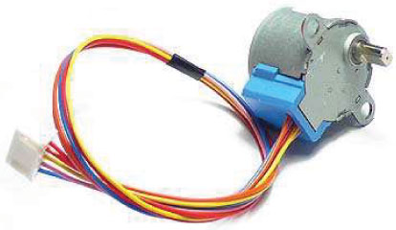
Specifications of Stepper Motor
Stepper motor is a brushless DC motor that divides the full rotation angle of 360° into number of equal steps.
We are using 28BYJ-48 stepper motor for this project which is cheap and easily available. It is 5V DC unipolar stepper motor. We are also using a Module available with this motor which consist ULN2003 Stepper Motor Driver IC.
Some step motor details:
Model: 28KYJ-48
Voltage: 5VDC
Phase: 4
Current : 160 mA per winding (320 mA in 4-step mode)

Slide 7
Continue..
Step Angle (8-Step sequence):
A-AB-B-BC-C-CD-D-DA
5.625° (64 steps per revolution)
Step Angle (4-Step sequence):
AB-BC-CD-DA
11.25° (32 steps per revolution)
Gear Reduction ratio: 1 / 64 (Not really exact: probably 63.68395.:1 )
SO: it takes (64*64 = 4096 steps per output shaft revolution.. In 8-step sequence.
SO: it takes (32*64 = 2048 steps per output shaft revolution.. In 4-step sequence.

Slide 8
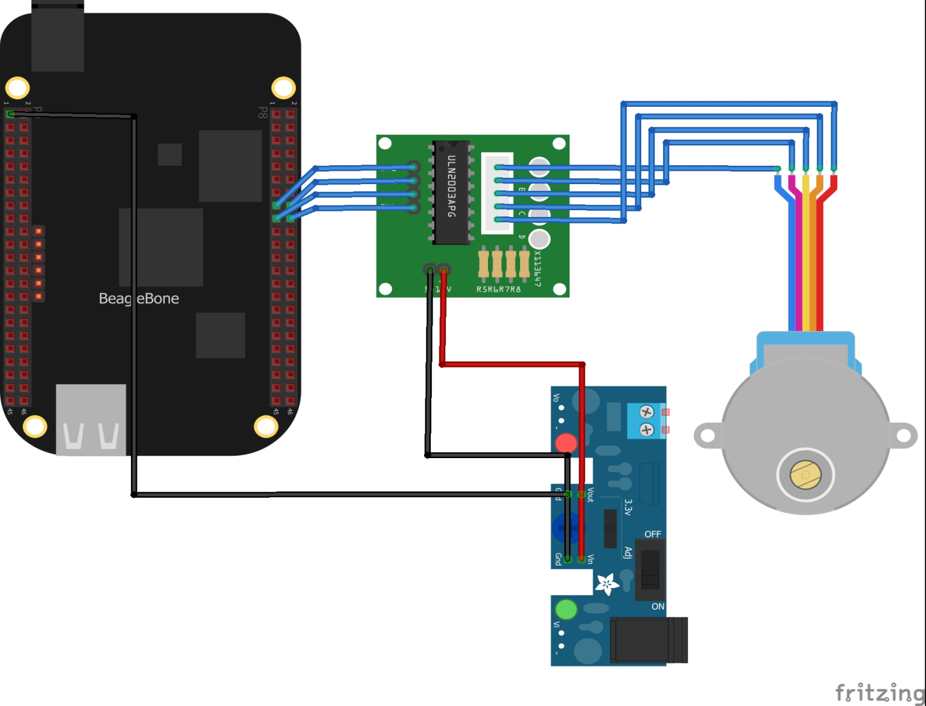
Connection diagram of Beaglebone Black with Stepper Motor using ULN 2003 driver circuit

Slide 9
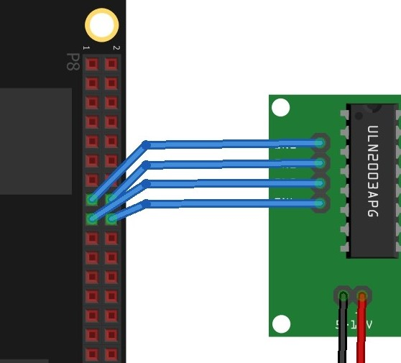
Pin connections between BBB and ULN 2003 Driver Circuit
ULN2003AN Driver Circuit – The driver receives a command, interprets it, and send the necessary power to the step motor to achieve a step.
The ULN 2003AN board can supply between 5V to 12V to the motor from an independent power supply module.
The ground pin of ULN2003 is connected to ground pin of power module.
The +5v pin of ULN 2003 is supplied with 5v from power module.
BeagleBone Black |  | Drive Board
GPIO Pin | Pin | Pin
GPIO_47 | p8.15 | IN1
GPIO_46 | p8.16 | IN2
GPIO_27 | p8.17 | IN3
GPIO_65 | p8.18 | IN4

Slide 10
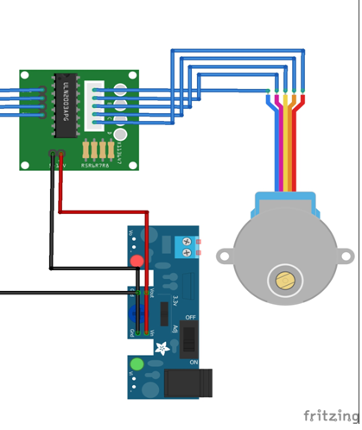
Pin connection between Stepper Motor and ULN2003AN driver IC.
The motor steps when a specific combination of wires running to the motor are powered. This is just a pulse of power. Just enough to get the motor to step.
The driver and motor use a very simple protocol. Applying a signal to an input pin causes power to be sent to the motor on a corresponding wire.
The motor steps when specific combinations of its wires are powered and the same combination is used to signal the driver.
Step Angle (4-Step sequence): 11.25° (32 steps per revolution)
It takes 32*64 = 2048 steps per output shaft revolution. In 4-step sequence.
4 Step sequence : AB – BC – CD – DA
Step | Command | IN4 | IN3 | IN2 | IN1
AB | 03H | 0 | 0 | 1 | 1
BC | 06H | 0 | 1 | 1 | 0
CD | 0CH | 1 | 1 | 0 | 0
DA | 09H | 1 | 0 | 0 | 1
ULN2003 | Code | Wire Color
IN1 | A | Blue
IN2 | B | Pink
IN3 | C | Yellow
IN4 | D | Orange

Slide 11
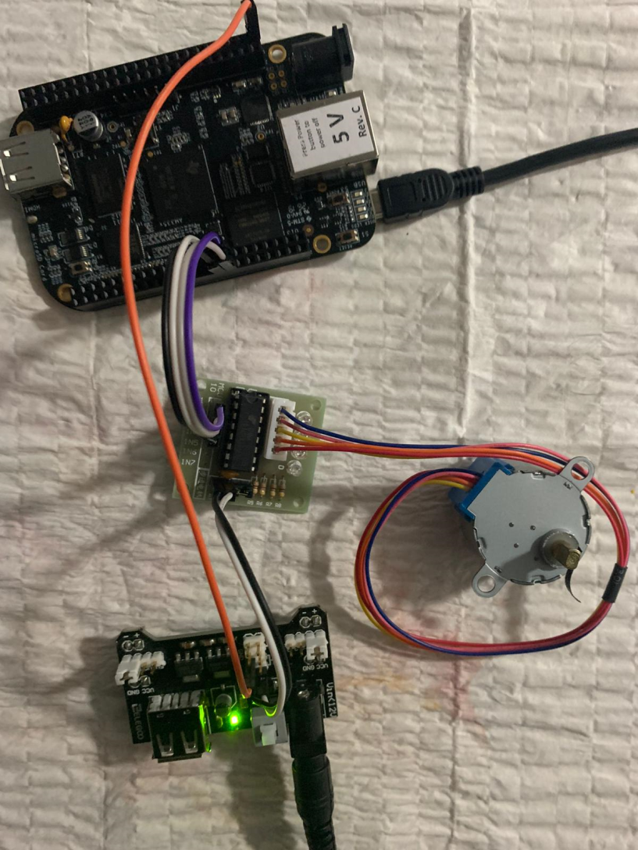
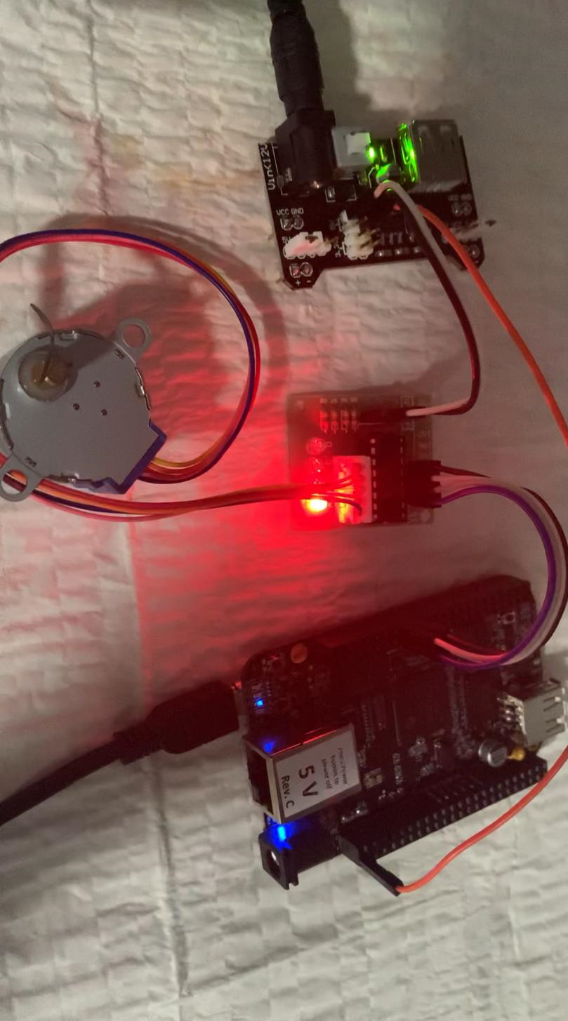
Circuit Diagram

Slide 12
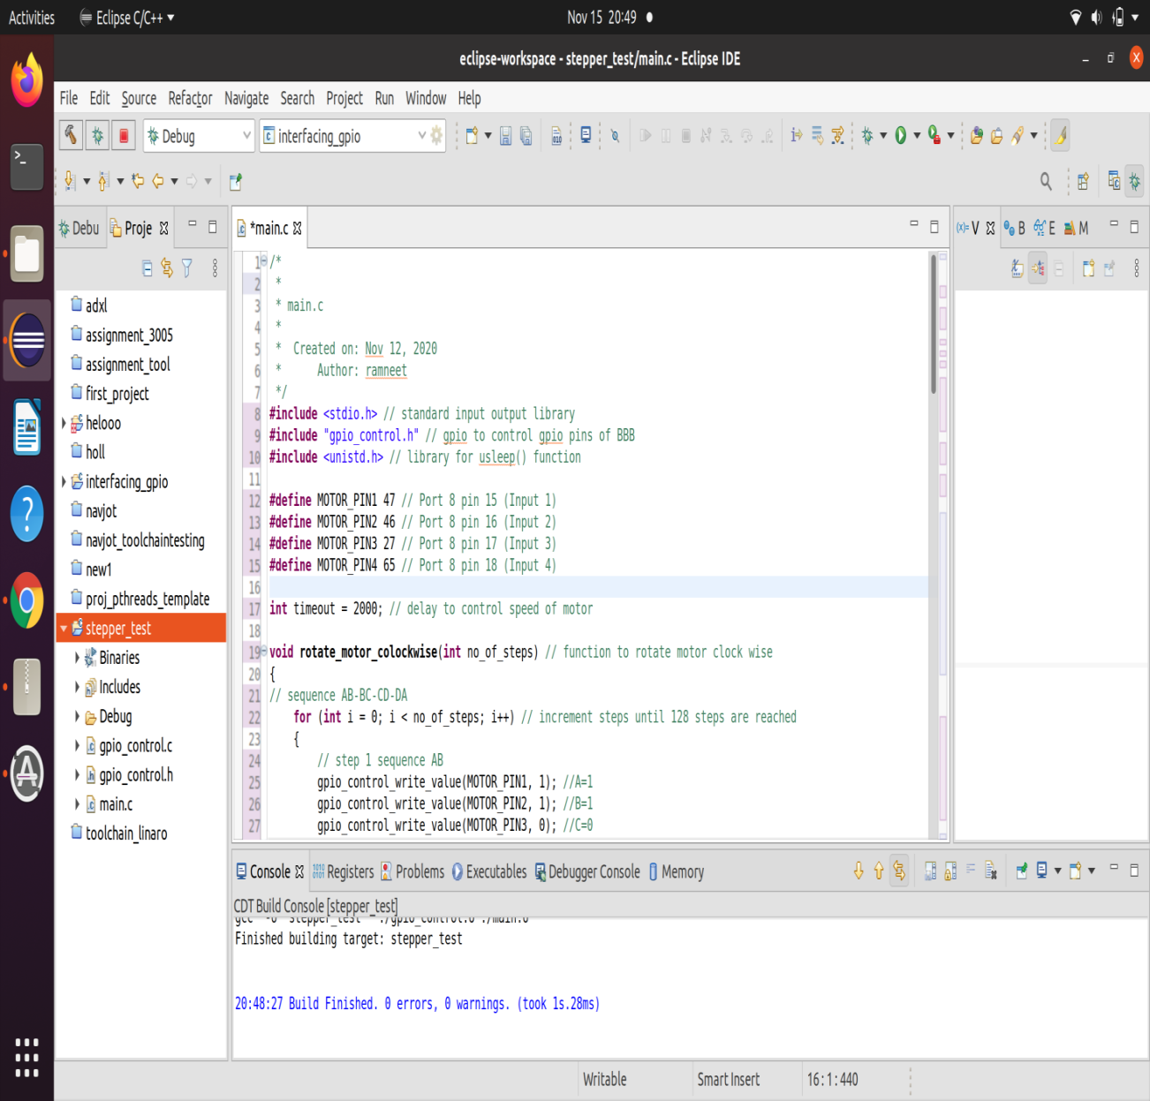
Software Code- Eclipse IDE
The whole project is written, build and compiled in Eclipse IDE.
The gpio pins of the Beaglebone Black are controlled using gpio.c and gpio.h Files.
The gpio pins are controlled by file system.
The stepper motor is interfaced with Beaglebone black over gpio pins 47, 46,27 and 65 of port 8.

Slide 13
Overview of the Code
In the main code, 4 step sequence is followed to control the rotation of the stepper motor in clockwise and anticlockwise direction.
Total number of the steps taken for full rotation of 360 degree is 2038.
However, we are going to rotate motor by 90 degree in clockwise and anticlockwise directions. In the upcoming slides, steps will be explained in detail from main.c code to rotate motor by 90 degree.

Slide 14
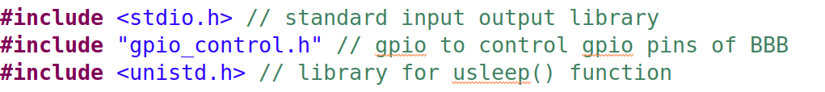
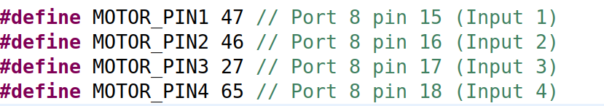
Continue..
The list of Header files included in main.c file are:
Stdio.h as standard input and output library.
Gpio_control.H file to initialize gpio pins of BBB
Unistd.h mainly used for usleep () function.
The following pins are declared as motor pins :
Input 1 of motor (wire A) is GPIO Pin 47(port8 pin15)
Input 2 of motor (wire B) is GPIO Pin 46(port8 pin16)
Input 3 of motor (wire C) is GPIO Pin 27(port8 pin17)
Input 4 of motor (wire D) is GPIO Pin 67(port8 pin18)
The variable timeout is used to control speed of the motor. That is mainly given in form of delay

Slide 15
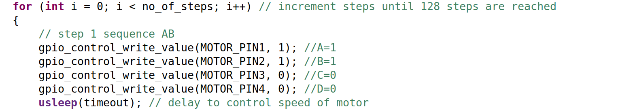
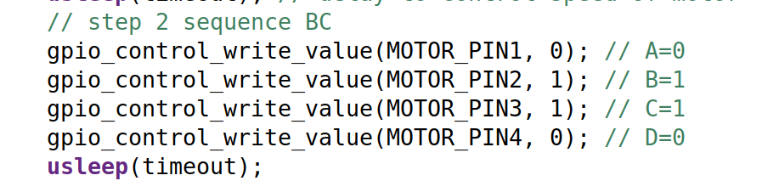
Continue..
ULN2003 | Code | Wire Color
IN1 | A | Blue
IN2 | B | Pink
IN3 | C | Yellow
IN4 | D | Orange
Rotate_motor_clockwise( int no_of_steps):
The void rotate_motor_colockwise(int no_of_steps) function is defined.
The number of steps taken for 90 degree is 128 in clockwise direction.
Within each step, further motor takes 4 steps. AB-BC-CD-DA
Therefore, total steps required for 90 degree rotation is 128*4= 512.
This function mainly rotate motor at 90 degree in clockwise direction. In the function, 4 steps are defined, that is, AB, BC, CD and DA.
In step 1, A and B wire are high. This means that Blue and Pink wire are given logic 1.
In step 2, B and C is given logic 1, This means Pink and Yellow wires are at high level.
In step 3, C and D is given logic 1. That is Yellow and Orange wire.
In step 4, D and A is given 1, that is, Orange and Blue wire.

Slide 16
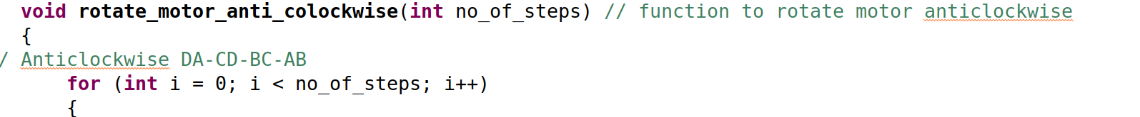
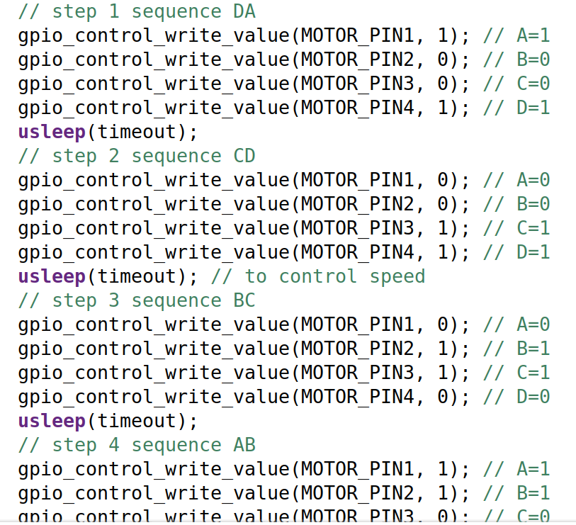
Continue..
void rotate_motor_anti_colockwise(int no_of_steps):
The motor is rotated 90 degree in anti clockwise direction.
The number is steps is 128.
Each step is defined in 4 step sequence that are as follows:
DA-CD-BC-AB
In step 1, D and A is given 1, that is, Orange and Blue wire.
In step 2, C and D is given logic 1. That is Yellow and Orange wire.
In step 3, B and C is given logic 1, This means Pink and Yellow wires are at high level.
In step 4, A and B wire are high. This means that Blue and Pink wire are given logic 1.

Slide 17
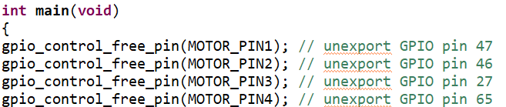
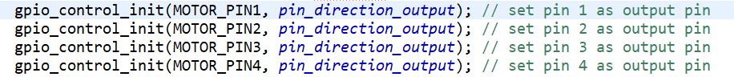
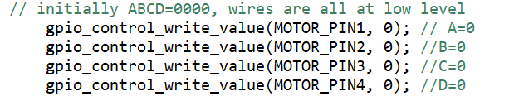
Continue…
Main() function:
The first step is to set the pins free to be used in the code.
Then, set all the 4 pins of motor as output pins using gpio_control_init() function defined in the gpio.c file.
Initially, all the pins are at low level, that means all wires are at logic level 0.

Slide 18
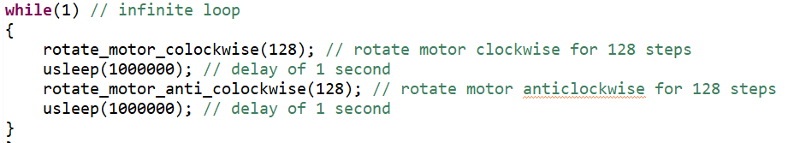
Continue…
Inside the infinite while loop, the motor is rotated 90 degree in clockwise direction.
Then delay of 1 second is given using usleep(1000000) function. The usleep() function give delay in microseconds.
After that, motor is rotated in anticlockwise direction by 90 degree.
Again, delay of 1 second is given.
The loop is infinite and keeps on repeating.

Slide 19
Running code on Beaglebone Black
The whole project is compressed and transferred to Beaglebone Black using sftp command.
Login as: sftp debian@192.168.7.2
Sftp > put stepper_test.tar.xz
Then, file is uncompressed using command:
Extracting the tar.xz file in Beaglebone black
tar –xf stepper_test.tar.xz

Slide 20
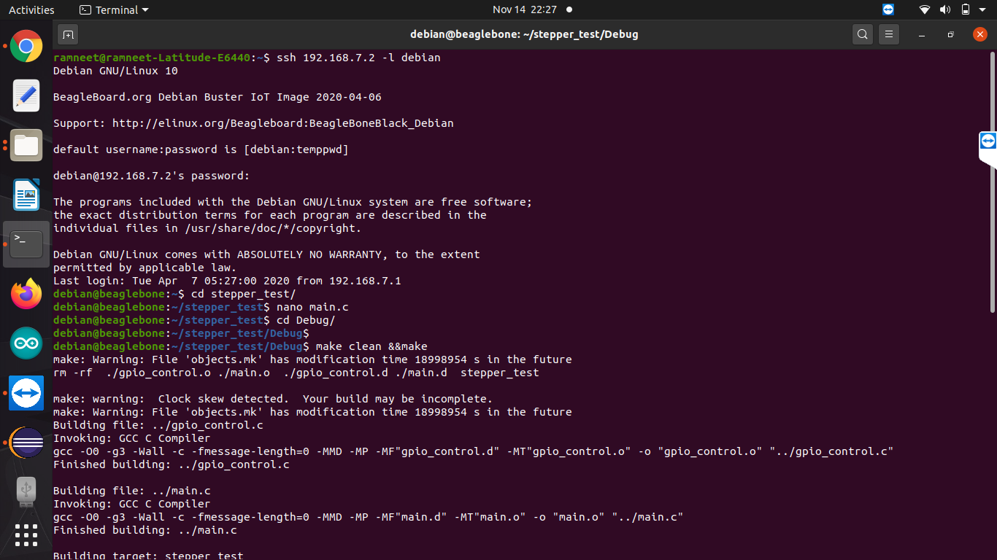
Continue..
The first step is to make a object file of stepper_test project.
Use commands, make clean and make.

Slide 21
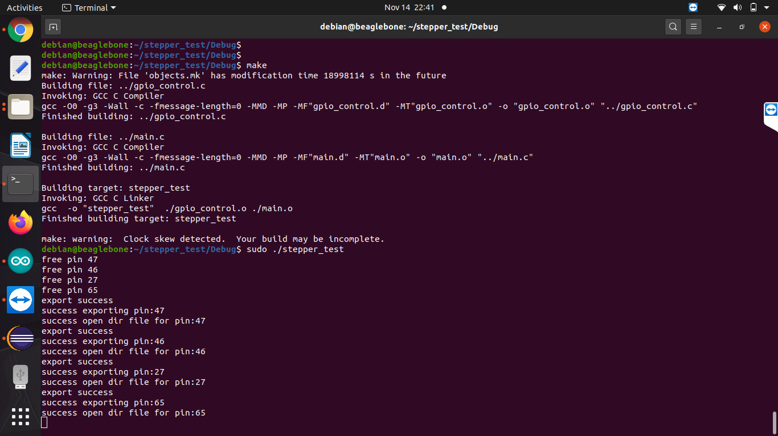
Stepper motor code running on BBB
To run the project, command is:
Sudo ./stepper_test

Slide 22
References
Developer.ridgerun.com. (n.d.). How to use GPIO signals. Retrieved from https://developer.ridgerun.com/wiki/index.php/How_to_use_GPIO_signals#GPIO_interrupts_from_user_space
Krishnan. (n.d.). gist_github.com_krishnan. Retrieved from github.com: https://gist.github.com/krishnan793/29c75261168040c99102
RidgeRun. (2011). Gpio-int-test.c. Retrieved from https://developer.ridgerun.com/: https://developer.ridgerun.com/wiki/index.php?title=Gpio-int-test.c
28BYJ-48 – 5V Stepper Motor . (n.d.). Retrieved from Kiatronics: https://datasheetspdf.com/pdf-file/1006817/Kiatronics/28BYJ-48/1
Helen. (2018). Dummies guide on driving a 28BYJ-48 Stepper Motor with a ULN2003 Driver Board and Arduino. Retrieved from Seedstudio.com: https://www.seeedstudio.com/blog/2019/03/04/driving-a-28byj-48-stepper-motor-with-a-uln2003-driver-board-and-arduino/
Rawashdeh, M. (n.d.). BYJ48 Stepper Motor. Retrieved from Instructables: https://www.instructables.com/BYJ48-Stepper-Motor/
Green, B. (2012, April 3). BeagleBone – Stepping Out. Retrieved from BWGZ57: https://bwgz57.wordpress.com/2012/04/03/beaglebone-stepping-out/
BeagleBoard.org. (n.d.). BeagleBone Black. Retrieved from https://beagleboard.org/black
Molloy, D. Exploring BeagleBone, Second Edition. Wiley.

Slide 23
Thank You

